Slide 1





JDR and examples of successful studies - lessons from the MOPED and DYADs study
Dr Barbora Šilarová (she/her)
Personal Social Services Research Unit (PSSRU)
University of Kent

Slide 2



The Measuring outcomes of people with dementia and their carers (MOPED) study
The dyadic wider impact of social care: support for older carers and the people they care for (DYADS) study

Slide 3
Disclaimer
This presentation presents independent research funded by the NIHR under its Research for Patient Benefit (RfPB) Programme (Grant Reference Number: NIHR200058) and the National Institute for Health Research School for Social Care Research.
The views expressed are those of the author(s) and not necessarily those of the NIHR or the Department of Health and Social Care.

Slide 4

About the project: the MOPED study
To test two new questionnaires that are part of the Adult Social Care Outcomes Toolkit (ASCOT)
The ASCOT questionnaires are used to collect information on the quality of life of people who use social care services and their carers
ASCOT-Proxy and ASCOT-Carer

Slide 5
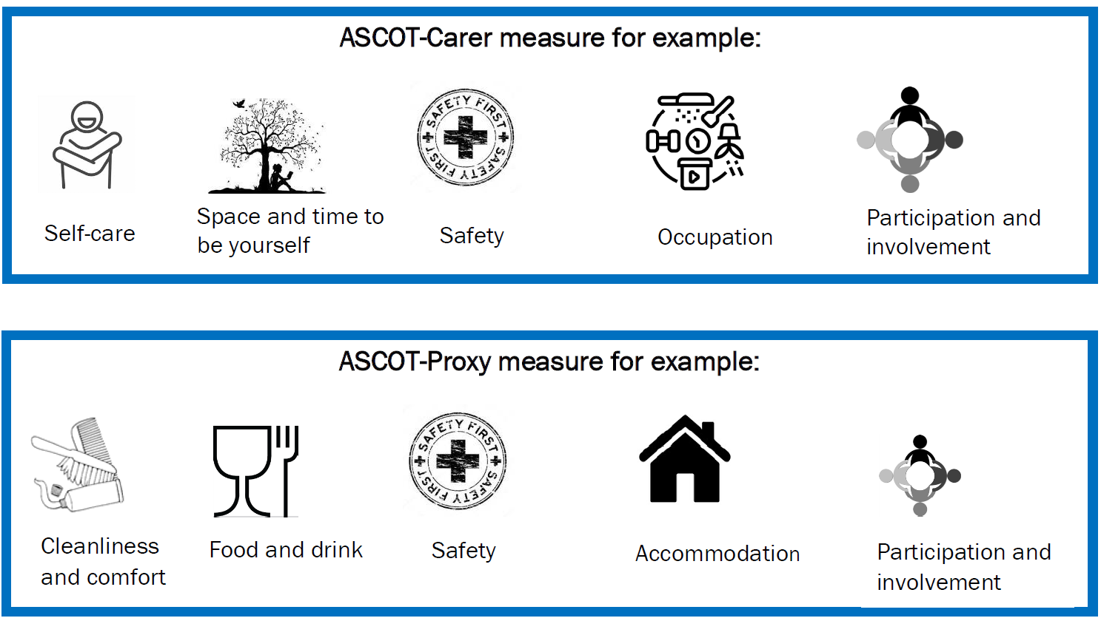
Background – ASCOT Proxy and ASCOT-Carer

Slide 6
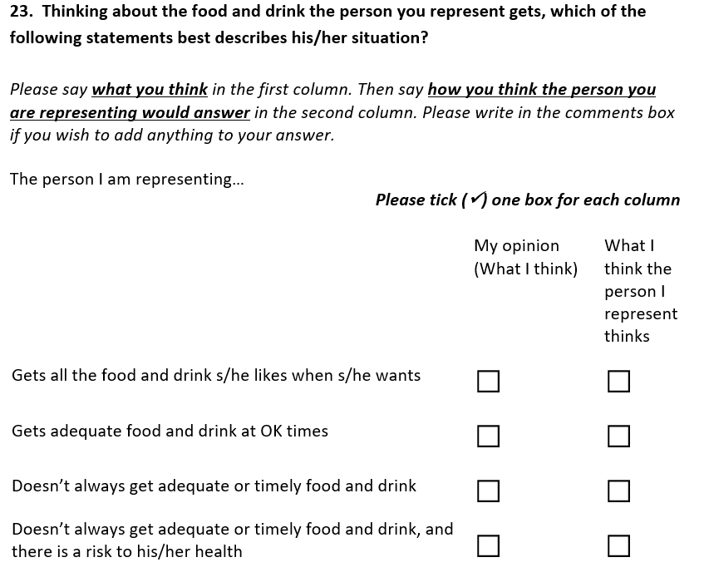
Ideal state
No needs
Some needs
High needs

Slide 7
About the project: the MOPED study
Is the ASCOT-Carer a valid and reliable measure of the social care outcomes of carers of people with dementia?
Is the ASCOT-Proxy a valid and reliable proxy-report measure of the social care outcomes of people with dementia?
What factors are associated with the quality of life of people with dementia in the community (by proxy-report) and their carers?

Slide 8
About the project: the MOPED study
300 carers of people with dementia to take part in a survey (online or paper form)
Inclusion criteria:
A friend or family member of someone living with dementia, who:
Lives at home (not in a nursing or residential care home)
Uses at least one type of social care service
Would not be able to answer a postal or online questionnaire, even with help.

Slide 9
How using JDR assisted with the completion of the study
Recruitment pathway | Before COVID-19 | During COVID-19 | Additional changes
The Join Dementia Research platform | One of the pathways | Key recruitment pathway 2872 invitations send between January and July 2020 | Simplified recruitment Second follow up during Autumn 2020
Carers’ organisations | Promoting the study Distributing the study packages | 10 organisations agreed to promote the study throughout July 2020 | Simplified adverts Additional advertising throughout September 2020
Local Authorities | RG approval Promoting the study Distributing the study packages | 8 LA issued RG approval | 12 randomly selected LA (out of 152) LA selected based on interest from carers’ organisation
Social media (Twitter) | One of the pathways | PSSRU Twitter account May 2020 | Simplified adverts During July, twice a week
The NHS | NA | From October 2020 key recruitment pathway 25 NHS sites | 10 amendments

Slide 10
How using JDR assisted with the completion of the study
Survey mode | Recruitment |  | Total
 | JDR | NHS
Postal | 8 | 55 | 63
Online (Qualtrics) | 165 | 85 | 250
Total | 173 | 140 | 313

Slide 11
The dyadic wider impact of social care: support for older carers and the people they care for (DYADS) study

Slide 12
About the project: the DYADs study
To understand the experience of carers aged over 65 years and the people they care for – both individually and together.
It looks at the ways social care services may improve the quality of life for the carer, as well as the person being cared for.

Slide 13
About the project: the DYADs study
24 carers as well as people they support to take part in an individual interview (online or via phone)
Inclusion criteria:
Carers aged 65 years or over and the person they support
Help, support or look after someone, who lives with them
Carer or the person they support has to use community-based services

Slide 14

How using JDR assisted with the completion of our study
Data collection via JDR started in April 2021 and will finish in December 2021
The JDR is used alongside Carers’ organisations and Local Authorities
Number of carers invited via JDR: 537
Number of people invited living with dementia: 357
Number of carers interviewed via JDR: 12
Number of DYADs interviewed via JDR: 7 (out of 9)

Slide 15
Top tips to use the JDR
Feasibility: Check how feasible a future study would be to set up.
You only need Ethical approval.
Access to a large number of volunteers.
Be patient as the response rate could be low.

Slide 16

Our Team - the MOPED study
Professor Karen Jones
Co-Investigator
Della Ogunleye
Research Advisor
Ann-Marie Towers
Co-Investigator
Aakta Patel
Research Advisor
Dr Stacey Rand
Chief Investigator

Slide 17
Our Team - the DYADs study
Professor Alisoun Milne
Co-Investigator
Christina Reading
Research Advisor
Dr Wenjing Zhang
Helen Ramsbottom
Research Advisor
Grace Collins
Dr Stacey Rand
Chief Investigator

Slide 18


Thanks for your attention!
Contact: b.silarova@kent.ac.uk
@BarboraSilarova

