Slide 1
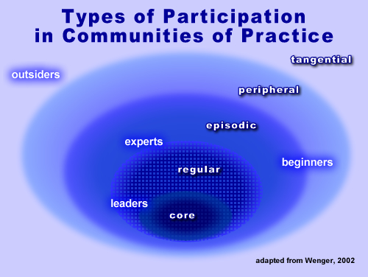
Including autistic stakeholders
Dr. Damian E M Milton

Slide 2
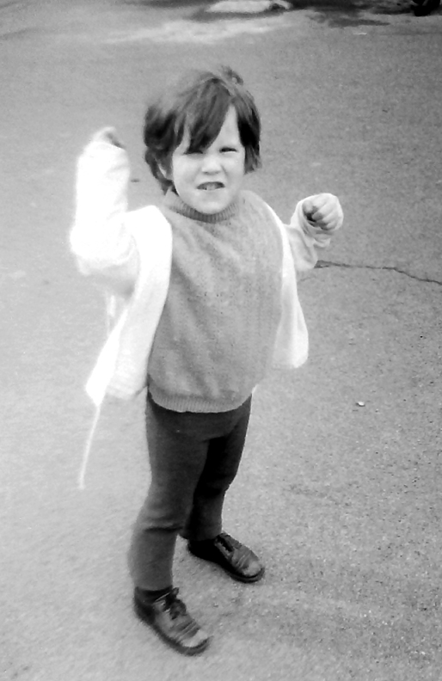
“Some of us aren’t meant to belong. Some of us have to turn the world upside down and shake the hell out of it until we make our own place in it.” (Lowell, 1999).

Slide 3
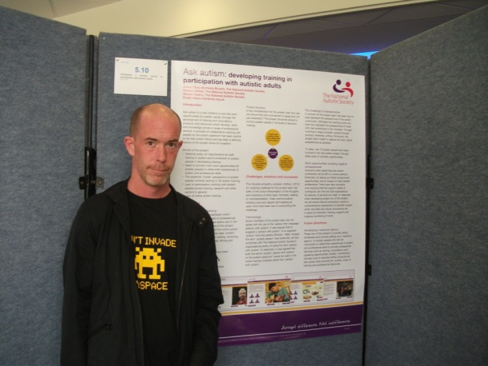
A growing understanding
Obtaining the views of disabled people – requirement of policy / legislation both nationally and internationally (UN, 2006).
Lack of involvement and representation in organisations ‘for’ autistic people.
Conflict between growing autistic voice and the discourse of dysfunction, deficiency, and dependency.
A Future Shaped Together (Pellicano et al. 2013).
The Shaping Autism Research UK project.

Slide 4
Nothing about us without us
Having an autonomous voice – an essential requirement for individual well-being.
For people on the autism spectrum however, there can be a number of barriers to participation in wider social life.
People on the autism spectrum have often been excluded from contributing towards the decisions that directly affect their own lives.
This has led many autistic-led advocacy groups to rally behind the slogan: ‘Nothing about us, without us’.

Slide 5
Idealised normalcy
“Another way to decide what to teach a child with autism is to understand typical child development. We should ask what key developmental skills the child has already developed, and what they need to learn next. The statutory curriculum in the countries of the UK also tells us what children should learn. Then there are pivotal behaviours that would help further development: teaching communication, social skills, daily living or academic skills that can support longer-term independence and choices.” (Prof. Richard Hastings, 2013: http://theconversation.com/behavioural-method-is-not-an-attempt-to-cure-autism-19782).

Slide 6
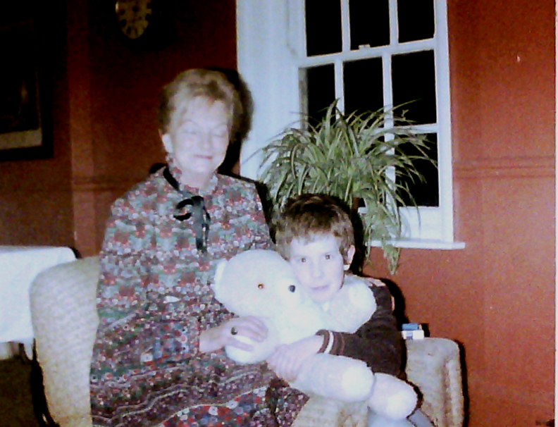
Normalisation and stigma
To be defined as abnormal in society, is often conflated with being perceived as 'pathological' in some way and to be socially stigmatised, shunned, and sanctioned.
The denigration of difference.

Slide 7
Empowerment
What is meant by ‘socially appropriate’, a ‘social rule’, ‘social skill’, ‘functional’?
By whose standards?
What it means to be ‘person-centred’ – mutual respect and understanding?

Slide 8
Mutual incomprehension
“95% of people don’t understand me”.
“Friends are overwhelming”.
“Adults never leave me alone”.
“Adults don’t stop bullying me”.
Quotes taken from Jones et al. (2012).

Slide 9

The double empathy problem
Building bridges between people of autistic and non-autistic dispositions is not always an easy process.
The different perceptual worlds of the differently socially (dis)positioned (Milton, 2012, 2014a, Chown, 2014).
Empathy problems as a ‘two-way street’ (Sinclair, 1992).
In this theory, it is not only the autistic person who struggles to read the intentions and motivations of non-autistic people, but the same can also be said in reverse.
Theory of autistic mind can often leave a great deal to be desired.
‘Fork ‘andles’!

Slide 10
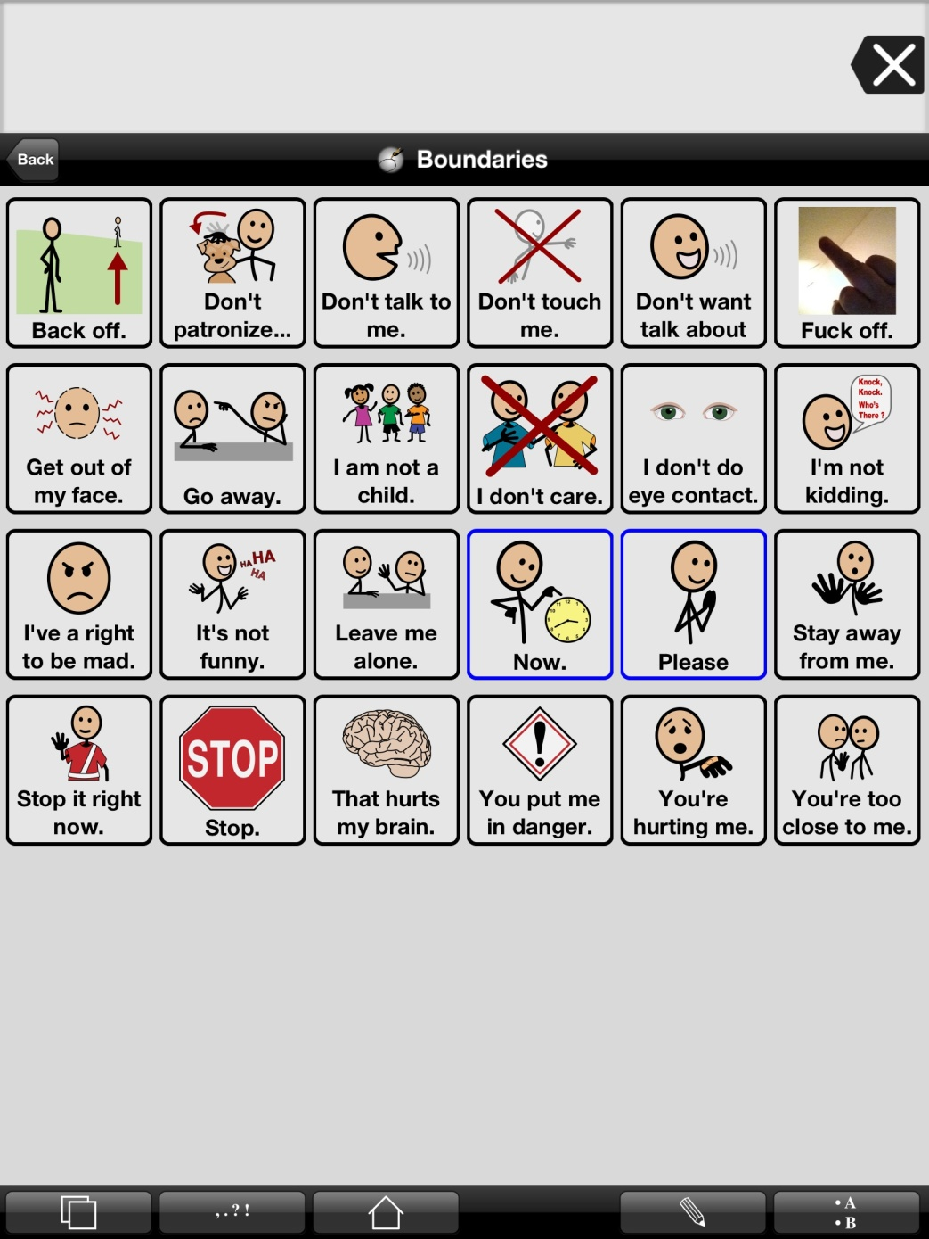
Aims and objectives – controversies in the field
Models of disability.
Normativity or the acceptance/celebration of diversity?
Behavioural outcomes and ‘social skills’ or understanding and autonomy?
Baggs (2012) - communication page.
Positivist RCTs and/or building collaborative communities of practice (Wenger, 1998).

Slide 11
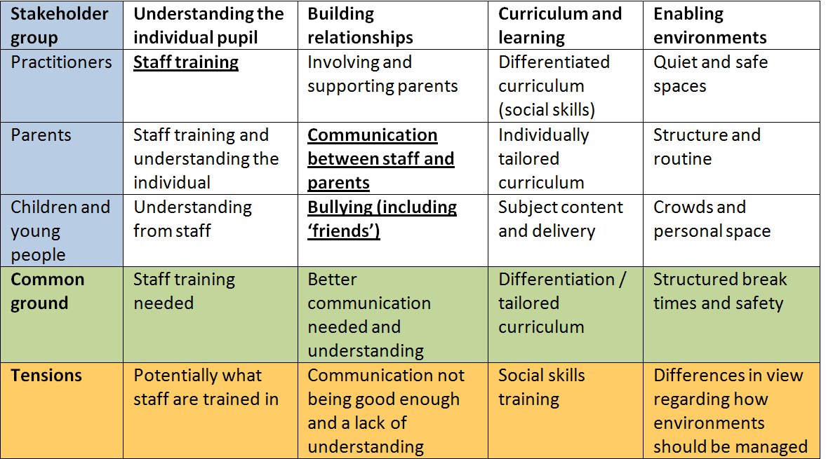
AET consultation data

Slide 12
Stakeholder perceptions
Findings from PhD research.
Significant tensions over a number of issues:
Celebrating the diversity of learners and not trying to ‘normalise’ them.
Radical change in society.
Pupil-led vs. teacher-led activities.
Social skills training and the appropriateness of behaviour.

Slide 13
A spectrum of educational views

Slide 14
Common ground?
Not a great deal!
Against extreme normalisation?
Enabling environments?
Building relationships, communication and mutual understanding.

Slide 15
Wellbeing and belonging
Meeting personal needs
Living with the consequences of an othered identity
Connection and recognition
Relationships and advocacy

Slide 16
Participatory research
A range of theoretical and methodological approaches.
Yet with the main objective of handing power from the researcher to research participants, who are often community members or community-based organisations.
In participatory research, participants have control over the research agenda, the process and actions taken.
Most importantly, people themselves are the ones who analyse and reflect on the information generated, in order to obtain the findings and conclusions of the research process.

Slide 17
Emancipatory research
“By definition emancipatory disability research should be judged mainly by its ability to empower disabled people through the research process, but whether this is achievable is a highly contentious issue.” (Barnes, 2001)

Slide 18

Collaboration
Avoiding tokenism...
“...place the voices and perspectives of self-advocates at the centre of the autism conversation, as we can speak with unique legitimacy and voice about our own lives.” (Ne’eman, 2011).

Slide 19
Potential barriers to inclusion
Cognitive and linguistic demands may impair full involvement for those with learning disabilities, yet hearing views is important for participation/contribution (Lewis and Porter, 2004).
Representativeness of peers and familiar adults as proxy informants (Lewis and Porter, 2004).
Pictures and schedules – not always sure that views reported were the children’s own (Preece and Jordan, 2009).

Slide 20
Inclusive strategies
Informed consent.
Opportunity for use of other mediums – drawing, photography, film – useful ‘aide-memoires’ (Powell and Jordan, 1992, cited in Preece and Jordan, 2009).
Concrete manipulation – piles of like and dislike. Photographic narratives / scrapbooks (Preece and Jordan, 2009).

Slide 21
Participatory methods in practice
The Autism Education Trust (AET) and the Transform Autism Education (TAE) project.
The Ask autism project.
The Theorising Autism Project.
The Autonomy journal.
The Cygnet mentoring project and the use of Personal construct theory (PCT).
The National Autism Project (NAP) and Westminster Commission.
Shaping Autism Research UK.
The Participatory Autism Research Centre (PARC) at London South Bank University.

Slide 22
The Participatory Autism Research Collective (PARC)
Network based at LSBU promoting participatory research in the field of autism studies.
Involving autistic adults and researchers, guest researchers and students.
Held meetings, presentations and book launches.
Led to publications and stream at Learning Disability Today conference.
Shortlisted for ‘most creative community project’ at National Autistic Society annual awards 2017.
PARCautism.co.uk

Slide 23
Conclusion
“Traditional methods of consulting and working in partnership may not always be effective, and new avenues for connection may need to be sought, however when collaborative ventures are pursued, and when people on the autism spectrum feel included and empowered, the ability to live as one chooses greatly increases.” (Milton, 2014b).

Slide 24
References
Barnes, C. (2001), accessed at: http://disability-studies.leeds.ac.uk/files/library/Barnes-glasgow-lecture.pdf
Chown, N. (2014) More on the ontological status of autism and double empathy, Disability and Society, Vol. 29(10): 1672-1676.
Lewis, A. and Porter, J. (2004) ‘Interviewing children and young people with learning disabilities: guidelines for researchers and multi-professional practice.’ British Journal of Learning Disabilities. Vol. 32: 191-197.
Lowell, E. (1999) Remember Summer. London: Avon.
Milton, D. (2012) On the Ontological Status of Autism: the ‘Double Empathy Problem’. Disability and Society. Vol. 27(6): 883-887.
Milton, D. (2014a) Autistic expertise: a critical reflection on the production of knowledge in autism studies. Autism: The International Journal of Research and Practice (special edition ‘Autism and Society’), Onlinefirst, 17/03/14.
Milton, D. (2014b) What is meant by participation and inclusion, and why it can be difficult to achieve. NAS Ask autism conference: Participation and inclusion from the inside-out: autism from an autistic perspective, London Jan 2014.
Ne’eman, A. (2011) Question and Answer interview, accessed at http://www.talkaboutautism.org.uk/community/live-qa-events/010611-ari-neeman
Pellicano, L., Dinsmore, A. and Charman, T. (2013) A Future Shaped Together: Shaping Autism Research in the UK. London: Institute of Education.
Preece, D. and Jordan, R. (2009) ‘Obtaining the views of children and young people with autism spectrum disorders about their experience of daily life and social care support.’ British Journal of Learning Disabilities. Vol. 38, pp. 10-20.
Sinclair, J. (1993) Don’t Mourn For Us [online] http://www.autreat.com/dont_mourn.html
United Nations (2006) Convention on the Rights of Persons with Disabilities. New York: United Nations.
Wenger, E. (1998) Communities of Practice: Learning, Meaning and Identity. Cambridge: Cambridge University Press.

